Slide 1
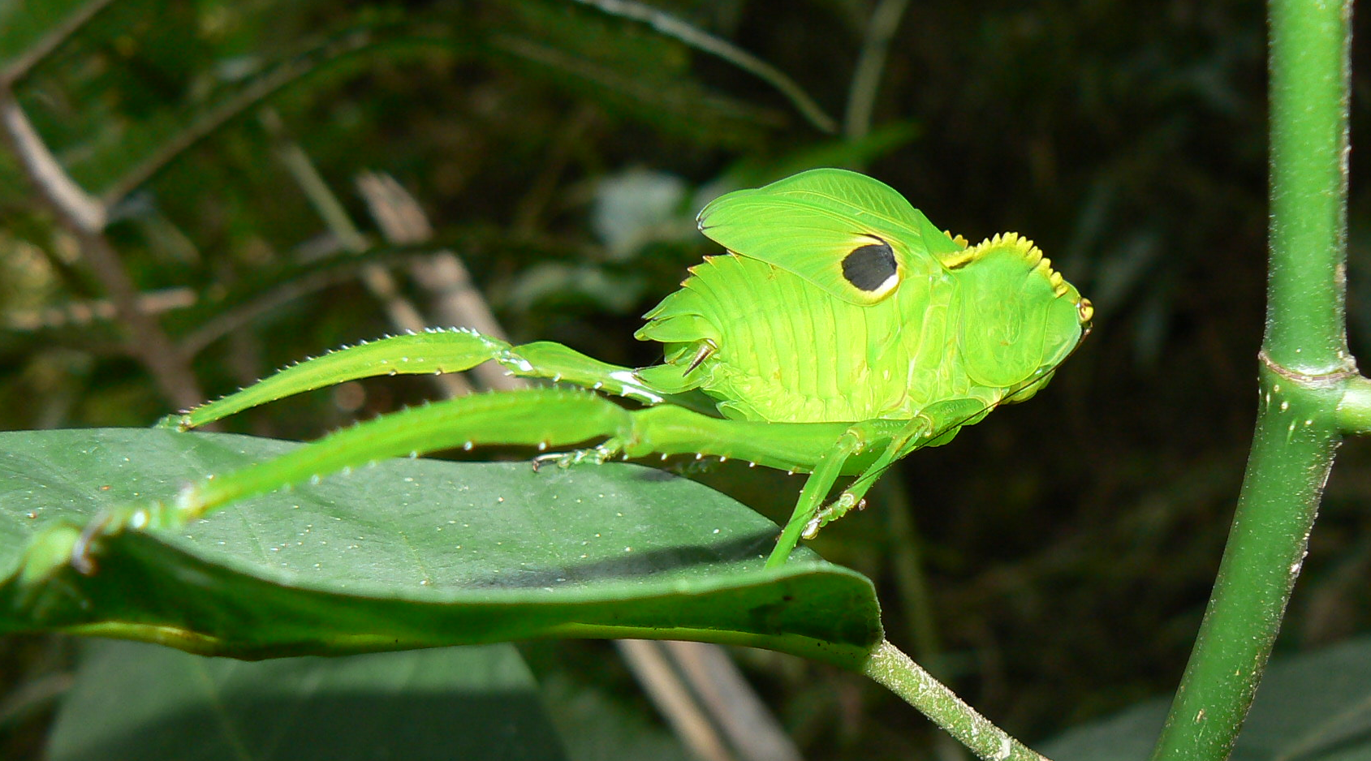
Ecdysozoans
Lab 8

Slide 2
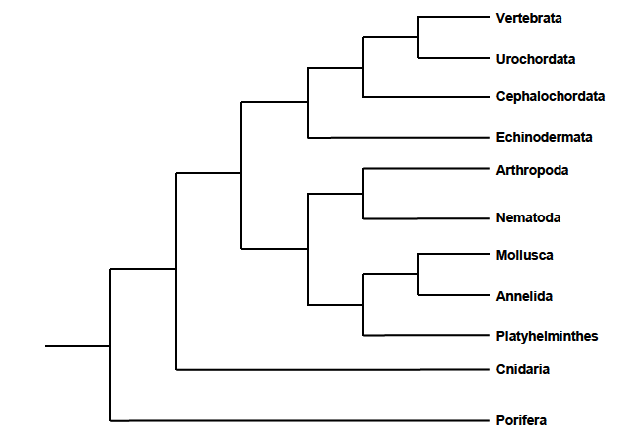
Ecdysozoans
Protostomia
Lophotrochozoans

Slide 3
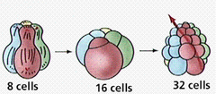
Protostomes
Exhibit spiral cleavage during embryonic development
Animals in which the mouth forms before the anus

Slide 4
Two Divisions of Protostomes
Lophotrochozoans: Grow by steadily increasing their body mass over time
e.g. Platyhelminthes, Annelida, Mollusca
Ecdysozoans: Grow by molting (ecdysis)
e.g. Nematodes and Arthropodia

Slide 5
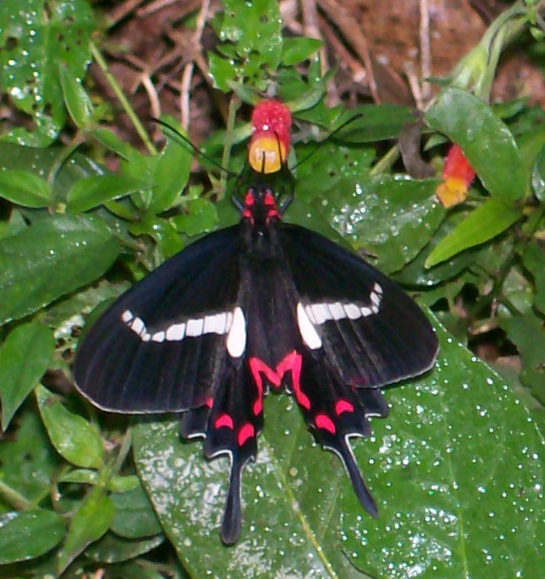
Phylum Arthropoda (“Arthro” = jointed, “poda” = foot)
Spiders, Horseshoe crabs, Insects, Crustaceans…

Slide 6
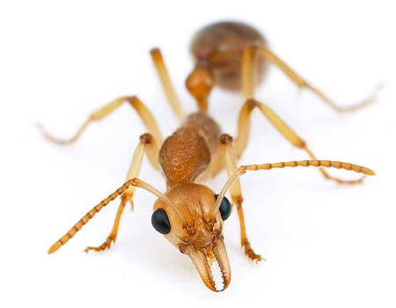
Arthropods
Largest animal phylum!
Rigid, nonliving exoskeleton
chitin and calcium carbonate
Jointed appendages
Regularly molt their exoskeleton
ecdysis
Giant Spider Crab Molting

Slide 7
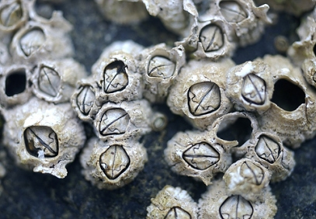
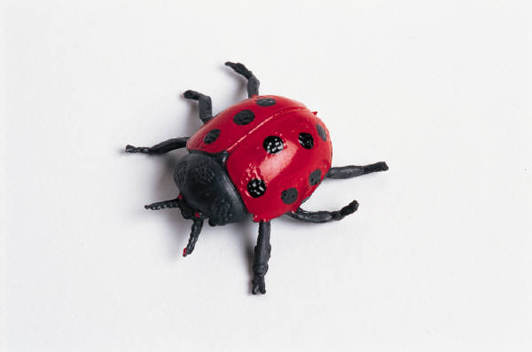
Arthropods
Regional muscles, positioned in bands in the body segment, for moving appendages
Open circulatory system
hemocoel and heart along dorsal blood vessel
Excretory system
Malpighian tubules and green glands

Slide 8
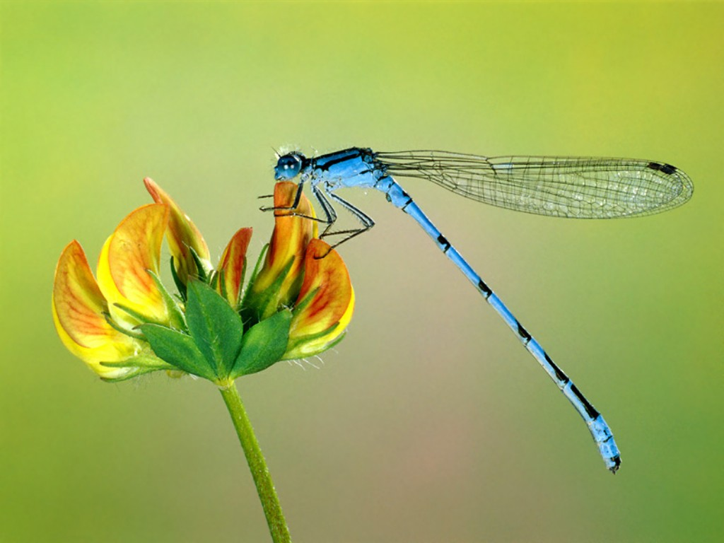
Basic Characteristics of Arthropods:
Protostome
Ecdysozoan
Bilateral symmetry
Triploblastic
Eucoelomate
Segmented body
Exoskeleton
Jointed appendages

Slide 9
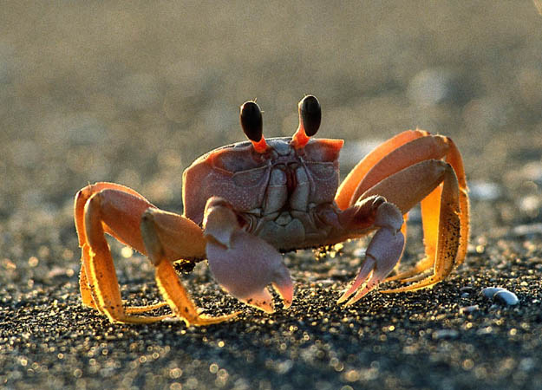
Reproduction
Varies widely
Most species have separate sexes and reproduce sexually
Except barnacles- mostly hermaphrodites
Fertilization is internal or external
Most terrestrial species have internal fertilization
Metamorphosis from larval stages to adult, or direct development

Slide 10
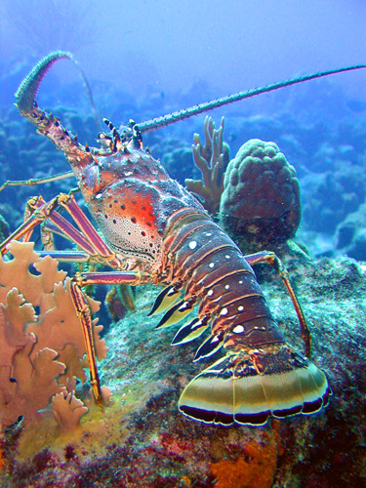
4 subphyla and 7 classes!
Subphylum Chelicerata
Class Arachnida
Class Merostamata
Subphylum Myriapoda
Class Diplopoda
Class Chilopoda
Subphylum Hexapoda
Class Insecta
Subphylum Crustacea
Class Malacostraca
Class (recently subclass) Cirripedia

Slide 11
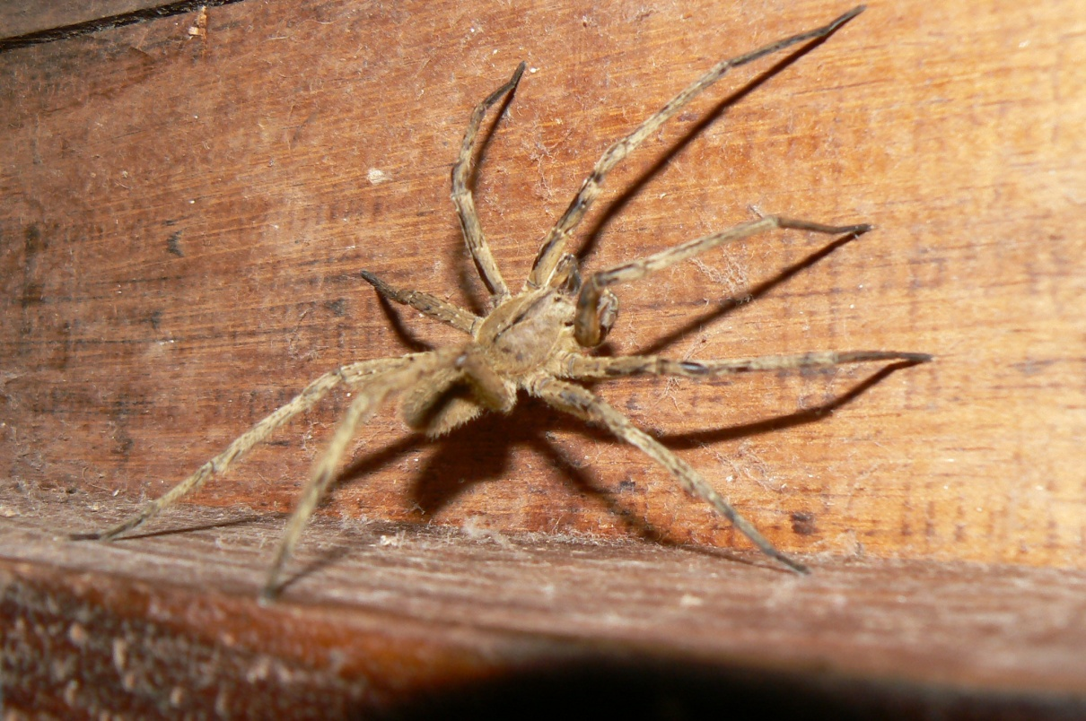
Subphylum Chelicerata
Have a pair of chelicerate – appendages near the mouth that aid in feeding and in some species contain venom
Have 4 pairs of legs
Class Arachnida
Class Merostamata

Slide 12
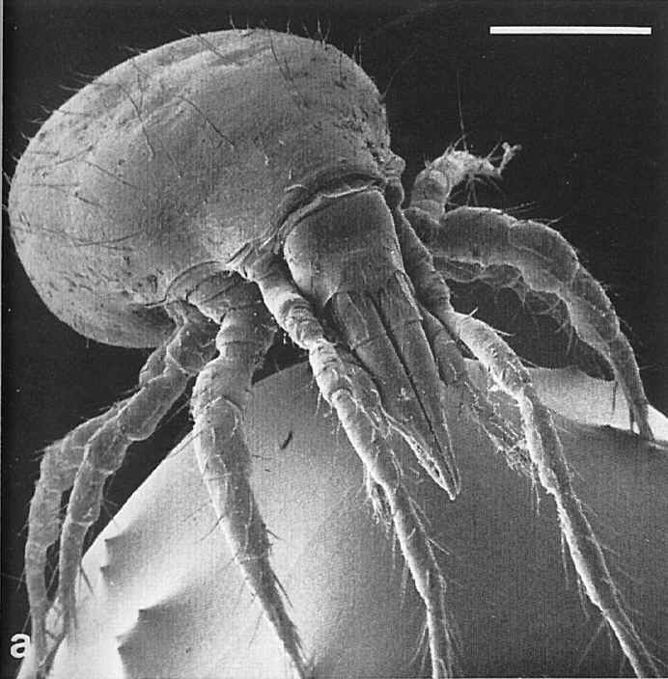
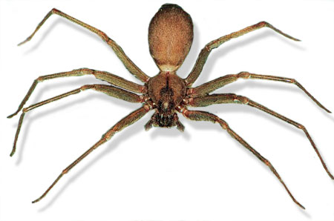
Class Arachnida
Scorpions, spiders, ticks, mites
The cephalothorax has a pair of chelicerae, a pair of pedipalps, and four pairs of walking legs
The abdomen is posterior to the cephalothorax
Excrete soluble waste through Malpighian tubules
Have simple eyes that are not image-forming
Almost all species of arachnids live in terrestrial habitats

Slide 13
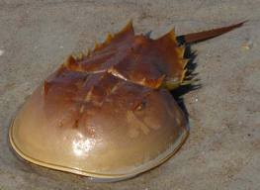
Class Merostamata Horseshoe Crabs
Have a spiked terminal segment called a telson
Extremely ancient animals (“living fossils”) – have been around ~570 million years
Important in marine pharmacology – blood has been used to keep drugs, vaccines, and medical devices free of bacterial contamination
Live in shallow water, sandy bottom habitats
Migrate to shallow, coastal water habitats (intertidal zone) along eastern US and Gulf of Mexico to breed

Slide 14
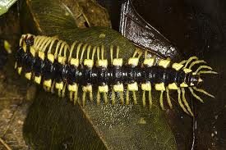
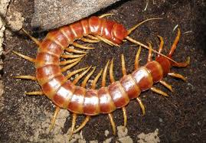
Subphylum Myriapoda
Have many legs (“myriad” inferring many)
Inhabit terrestrial environments
Class Diplopoda
Class Chilopoda

Slide 15
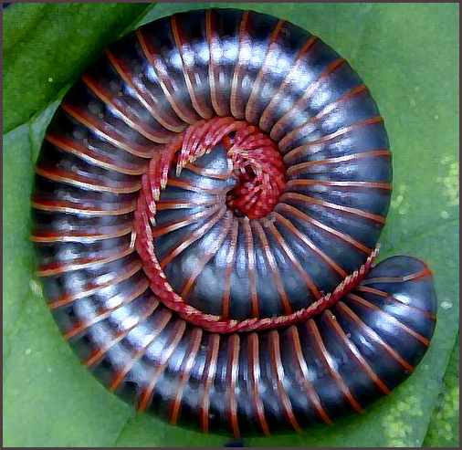
Class Diplopoda
Millipedes
Each trunk segment is fused into pairs, so each segment has 2 pairs of legs
Each segment has ganglia and ostia
The cuticle has a waxy layer which allows them to roll into a ball or coil
Feed on detritus – decomposing organic matter

Slide 16
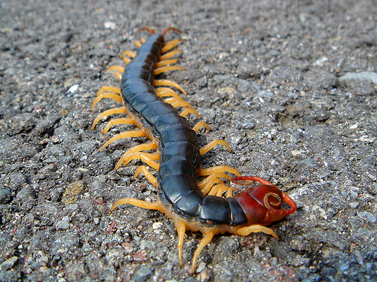
Class Chilopoda
Centipedes
Have numerous unfused segments and each segment (except for the first and last two) have a pair of walking legs
The first segment has a modified pair of appendages that contain venom (poison fangs)
Mostly carnivorous

Slide 17
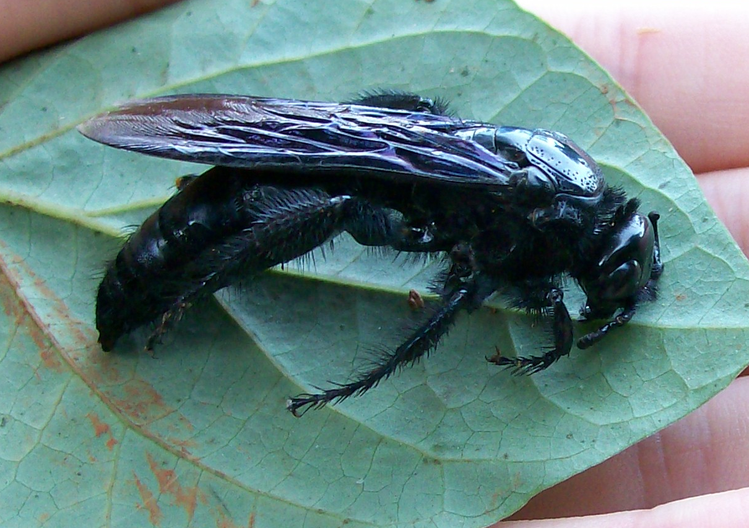
Subphylum Hexapoda
Have 3 pairs of legs – 6 total legs (“Hex” = six)
Most species-rich subphylum of arthopods
Class Insecta

Slide 18
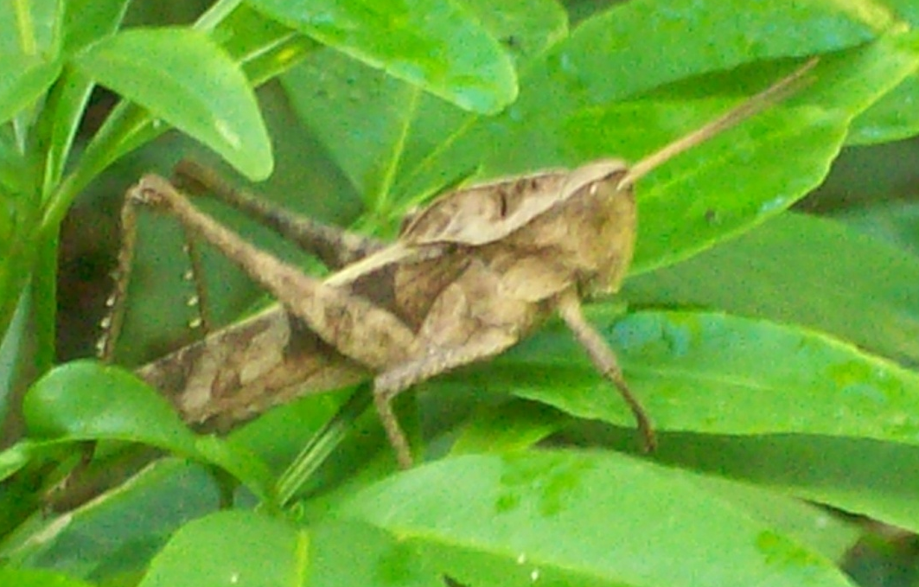
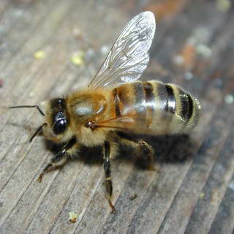
Class Insecta
Beetles, bees, flies, mosquitoes, ants
Bodies are composed of a head, thorax, and abdomen
Have a pair of compound eyes
Have wings on the second and third thoracic segments

Slide 19
Subphylum Crustacea
Over 30,000 species – important commercially and ecologically
Have a body composed of a head that is made of 5 segments, and a trunk that is made of a thorax and an abdomen
Mouthparts are made of mandibles, which are modified appendages
Appendages are multiarticulate (have several joints) and biramous (two branches)
Undergo metamorphosis from larval life stage into adult
Have gills for gas exchange
Most species have a carapace that covers some of the dorsal segments of the head and thorax, and acts as protective shield
Inhabit marine (shallow and deep ocean), brackish, and freshwater environments
Class Malacostraca
Class (subclass) Cirripedia

Slide 20
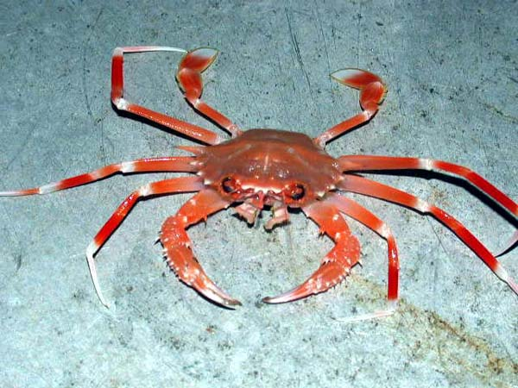
Class Malacostraca
Crabs, lobsters, shrimp, pill bugs
Largest class of crustaceans
Crabs can range in size from a few millimeters to 3.7 meters (including legs)
Lobsters can grow up to 1.5 m in length and are long-lived (living 100+ years)

Slide 21
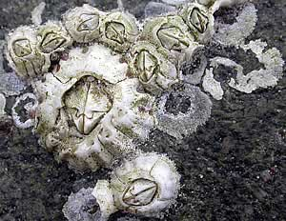
Class (subclass) Cirripedia
Barnacles
Adult barnacles are the only
sessile crustaceans
As larvae, barnacles are pelagic
Have a shell composed of plates
Survive well in harsh environments, including intertidal zone, by withdrawing into their shell, which maintains a wet internal environment

Slide 22
Field Trip!
Insect collection outside around the greenhouse
Each pair needs to find an INSECT to use for the activities
Collection cups at the front

Slide 23
Start Activities!
Key out your insect!
Lab Manual p. 120-122
Crayfish Dissection
Complete Character Table for Arthropods
Add characters to your phylogenetic tree
Homework
Echinoderm/Chordate Species Spotlight
Study for Quiz
Practical in TWO WEEKS!

Slide 24
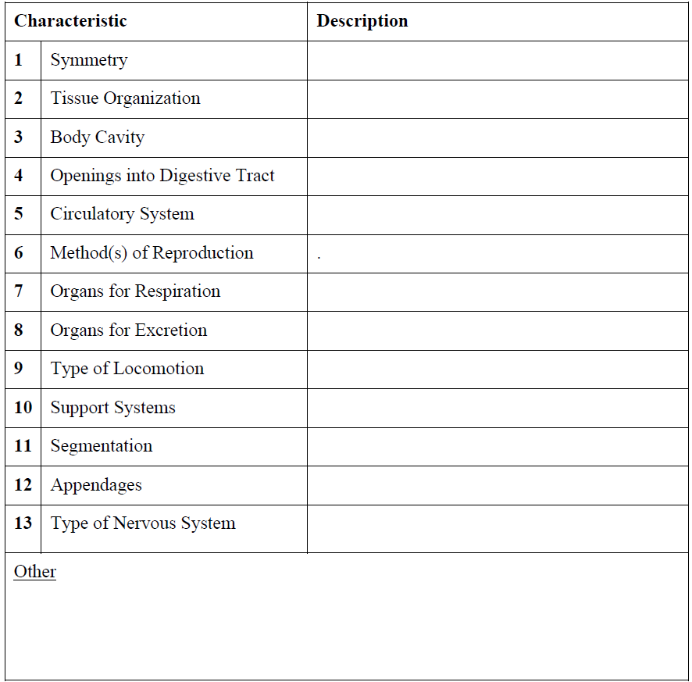
Phylum Arthropoda
Bilateral Symmetry
Triploblastic
Eucoelomate
Two Openings (complete)
Open
Sexual (Barnacles- hermaphroditic)
Gills (aquatic) & Tracheal System (terrestrial)
Nephridia (green glands & malpighian tubules)
Walking, swimming, flying & jumping
Exoskeleton
Segmented, Regional Specialization
Jointed Appendages
Cephalization, dorsal brain, ventral nerve cords

Slide 25
Ecdysis, Green Glands, Jointed Appendages, Exoskeleton, Malpighian Tubules, Open Circulatory System

